Slide 1
Intro to Cloud Computing CS4037 (BCS-6A) Lecture 10
Danyal Farhat
FAST School of Computing
NUCES Lahore

Slide 2
Module 6: Compute
AWS Academy Cloud Foundations

Slide 3
Module overview
Topics
Compute services overview
Amazon EC2
Amazon EC2 cost optimization
Container services
Introduction to AWS Lambda
Introduction to AWS Elastic Beanstalk
Lab
Introduction to Amazon EC2

Slide 4
Module objectives
After completing this module, you should be able to:
Provide an overview of different AWS compute services in the cloud
Demonstrate why to use Amazon Elastic Compute Cloud (Amazon EC2)
Identify the functionality in the EC2 console
Perform basic functions in Amazon EC2 to build a virtual computing environment
Identify Amazon EC2 cost optimization elements
Demonstrate when to use AWS Elastic Beanstalk
Demonstrate when to use AWS Lambda
Identify how to run containerized applications in a cluster of managed servers

Slide 5
Section 1: Compute services overview
Module 6: Compute

Slide 6













AWS compute services
Amazon Web Services (AWS) offers many compute services. This module will discuss the highlighted services.
Amazon EC2
Amazon EC2 Auto Scaling
Amazon Elastic Container Registry (Amazon ECR)
Amazon Elastic Container Service (Amazon ECS)
VMware Cloud on AWS
AWS Elastic Beanstalk
AWS Lambda
Amazon Elastic Kubernetes Service (Amazon EKS)
Amazon Lightsail
AWS Batch
AWS Fargate
AWS Outposts
AWS Serverless Application Repository

Slide 7
Categorizing compute services
Services | Key Concepts | Characteristics | Ease of Use
Amazon EC2 | Infrastructure as a service (IaaS) Instance-based Virtual machines | Provision virtual machines that you can manage as you choose | A familiar concept to many IT professionals.
AWS Lambda | Serverless computing Function-based Low-cost | Write and deploy code that runs on a schedule or that can be triggered by events Use when possible (architect for the cloud) | A relatively new concept for many IT staff members, but easy to use after you learn how.
Amazon ECS Amazon EKS AWS Fargate Amazon ECR | Container-based computing Run multiple workloads on single OS Instance-based | Spin up and run jobs more quickly | AWS Fargate reduces administrative overhead, but you can use options that give you more control.
AWS Elastic Beanstalk | Platform as a service (PaaS) For web applications | Focus on your code (building your application) Can easily tie into other services—databases, Domain Name System (DNS), etc. | Fast and easy to get started.

Slide 8
Choosing the optimal compute service
The optimal compute service or services that you use will depend on your use case
Some aspects to consider –
What is your application design?
What are your usage patterns?
Which configuration settings will you want to manage?
Selecting the wrong compute solution for an architecture can lead to lower performance efficiency
A good starting place—Understand the available compute options

Slide 9
Section 2: Amazon EC2
Module 6: Compute

Slide 10




Amazon Elastic Compute Cloud (Amazon EC2)
Example uses of Amazon EC2 instances
Application server
Web server
Database server
Game server
Mail server
Media server
Catalog server
File server
Computing server
Proxy server
Amazon EC2 instances
Photo by Taylor Vick on Unsplash
On-premises servers
Photo by panumas nikhomkhai from Pexels

Slide 11
Amazon EC2 overview
Amazon Elastic Compute Cloud (Amazon EC2)
Elastic – servers auto-scaling, sever size upgrade
Compute – Compute intensive servers
Cloud – VM on cloud
Provides virtual machines—referred to as EC2 instances—in the cloud.
Gives you full control over the guest operating system (Windows or Linux) on each instance.
You can launch instances of any size into an Availability Zone anywhere in the world.
Launch instances from Amazon Machine Images (AMIs).
Launch instances with a few clicks or a line of code, and they are ready in minutes.
You can control traffic to and from instances.
Amazon EC2

Slide 12
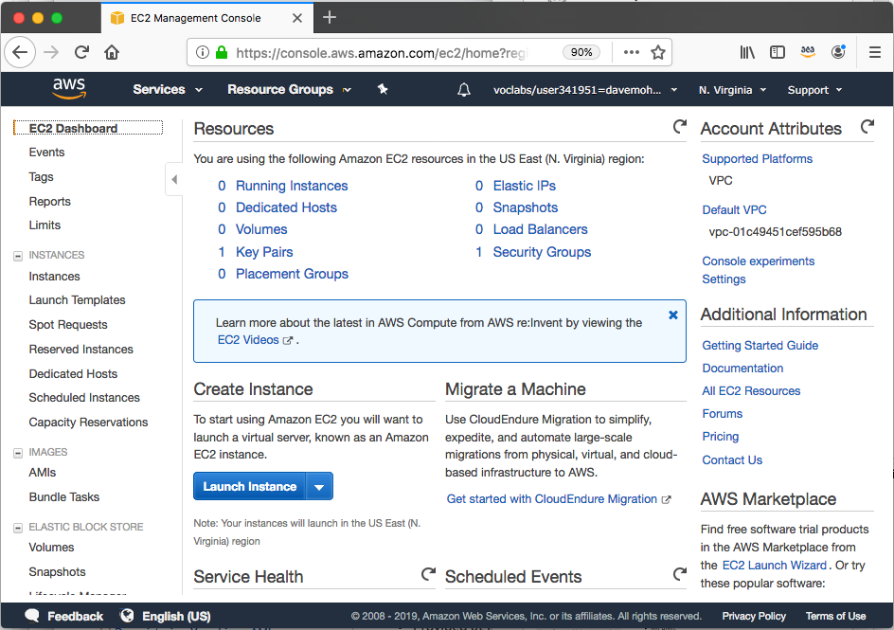
Launching an Amazon EC2 instance
This section of the module walks through nine key decisions to make when you create an EC2 instance by using the AWS Management Console Launch Instance Wizard.
Along the way, essential Amazon EC2 concepts will be explored.

Slide 13



1. Select an AMI
Choices made using the Launch Instance Wizard:
AMI
Instance Type
Network settings
IAM role
User data
Storage options
Tags
Security group
Key pair
Launch
instance
AMI
Instance
Amazon Machine Image (AMI)
Is a template that is used to create an EC2 instance (which is a virtual machine, or VM, that runs in the AWS Cloud)
Contains a Windows or Linux operating system
Often also has some software pre-installed
AMI choices:
Quick Start – Linux and Windows AMIs that are provided by AWS
My AMIs – Any AMIs that you created
AWS Marketplace – Pre-configured templates from third parties
Community AMIs – AMIs shared by others; use at your own risk

Slide 14


Creating a new AMI: Example
AWS Cloud
AMI details
Region A
Connect to the instance and manually modify it or run a script that modifies the instance (for example, upgrade installed software)
Quick Start or other
existing AMI
Launch an instance
Capture as a new AMI
Starter AMI
1
2
Modified
Instance
3
Unmodified
Instance
New AMI
(Optional) Import
a virtual machine
.ova / .ovf
MyAMI
Region B
Copy the AMI to any other Regions where you want to use it
New AMI
4
Notes:
When you create an AMI, Amazon EC2 stops the instance, creates a snapshot of its root volume, and finally registers the snapshot as an AMI.

Slide 15


2. Select an instance type
Consider your use case
How will the EC2 instance you create be used?
The instance type that you choose determines –
Memory (RAM)
Processing power (CPU)
Disk space and disk type (Storage)
Network performance
Instance type categories –
General purpose
Compute optimized
Memory optimized
Storage optimized
Accelerated computing
Instance types offer family, generation, and size
Choices made using the Launch Instance Wizard:
AMI
Instance Type
Network settings
IAM role
User data
Storage options
Tags
Security group
Key pair

Slide 16
EC2 instance type naming and sizes
Example instance sizes
Instance Name | vCPU | Memory (GB) | Storage
t3.nano | 2 | 0.5 | EBS-Only
t3.micro | 2 | 1 | EBS-Only
t3.small | 2 | 2 | EBS-Only
t3.medium | 2 | 4 | EBS-Only
t3.large | 2 | 8 | EBS-Only
t3.xlarge | 4 | 16 | EBS-Only
t3.2xlarge | 8 | 32 | EBS-Only
Instance type naming
Example: t3.large
T is the family name
3 is the generation number
Large is the size
Network bandwidth is tied with instance type

Slide 17




Select instance type: Based on use case
 | General Purpose | Compute Optimized | Memory Optimized | Accelerated Computing | Storage Optimized
Instance Types | a1, m4, m5, t2, t3 | c4, c5 | r4, r5, x1, z1 | f1, g3, g4, p2, p3 | d2, h1, i3
Use Case | Broad | High performance | In-memory databases | Machine learning | Distributed file systems

Slide 18
Instance types: Networking features
The network bandwidth (Gbps) varies by instance type.
To maximize networking and bandwidth performance of your instance type:
If you have interdependent instances, launch them into a cluster placement group.
For example, you might specify that three instances should all be deployed in the same Availability Zone to ensure lower network latency and higher network throughput between instances.
Enable enhanced networking.
Enhanced networking types are supported on most instance types.
See the Networking and Storage Features documentation for details.
Enhanced networking types –
Elastic Network Adapter (ENA): Supports network speeds of up to 100 Gbps.
Intel 82599 Virtual Function interface: Supports network speeds of up to 10 Gbps.

Slide 19




3. Specify network settings
Where should the instance be deployed?
Identify the VPC and optionally the subnet
Should a public IP address be automatically assigned?
To make it internet-accessible
Choices made by using the Launch Instance Wizard:
AMI
Instance Type
Network settings
IAM role
User data
Storage options
Tags
Security group
Key pair
AWS Cloud
Region
Availability Zone 1
Availability Zone 2
VPC
Example: specify to deploy the instance here
Public subnet
Instance
Private subnet

Slide 20


4. Attach IAM role (optional)
Will software on the EC2 instance need to interact with other AWS services?
If yes, attach an appropriate IAM Role.
An AWS Identity and Access Management (IAM) role that is attached to an EC2 instance is kept in an instance profile.
You are not restricted to attaching a role only at instance launch.
You can also attach a role to an instance that already exists.
Choices made by using the Launch Instance Wizard:
AMI
Instance Type
Network settings
IAM role
User data
Storage options
Tags
Security group
Key pair
Example:
Application on instance can access
attached to
Role that grants Amazon Simple Storage Service (Amazon S3) bucket access permissions
S3 bucket with objects
Instance

Slide 21
5. User data script (optional)
Choices made by using the Launch Instance Wizard:
AMI
Instance Type
Network settings
IAM role
User data
Storage options
Tags
Security group
Key pair
User data
#!/bin/bash
yum update –y
yum install -y wget
AMI
Running EC2 instance
Optionally specify a user data script at instance launch
Use user data scripts to customize the runtime environment of your instance
Script runs the first time the instance starts
User data script might patch and update the instance's operating system, fetch and install software license keys, or install additional software
Can be used strategically
For example, reduce the number of custom AMIs that you build and maintain

Slide 22
5. User data script (optional)
Choices made by using the Launch Instance Wizard:
AMI
Instance Type
Network settings
IAM role
User data
Storage options
Tags
Security group
Key pair
User data
#!/bin/bash
yum update –y
yum install -y wget
AMI
Running EC2 instance
#!/bin/bash
bash shell in use
yum update –y
update all softwares to the latest version
yum install -y wget
wget is a utility for downloading files from web (online repository)

Slide 23


6. Specify storage
Configure the root volume
Where the guest operating system is installed
Attach additional storage volumes (optional)
AMI might already include more than one volume
For each volume, specify:
The size of the disk (in GB)
The volume type
Different types of solid state drives (SSDs) and hard disk drives (HDDs) are available
If the volume will be deleted when the instance is terminated
If encryption should be used
Choices made by using the Launch Instance Wizard:
AMI
Instance Type
Network settings
IAM role
User data
Storage options
Tags
Security group
Key pair

Slide 24
Amazon EC2 storage options
Amazon Elastic Block Store (Amazon EBS) – Permanent
Durable, block-level storage volumes.
You can stop the instance and start it again, and the data will still be there.
Amazon EC2 Instance Store – Temporary
Ephemeral storage is provided on disks that are attached to the host computer where the EC2 instance is running.
If the instance stops, data stored here is deleted.
load balanced pool of web servers
Other options for storage (not for the root volume) –
Mount an Amazon Elastic File System (Amazon EFS) file system.
Connect to Amazon Simple Storage Service (Amazon S3).

Slide 25




Example storage options
Instance 1 characteristics –
It has an Amazon EBS root volume type for the operating system.
What will happen if the instance is stopped and then started again?
OS and data on EBS remains intact.
Data on ephemeral will be lost
Instance 2 characteristics –
It has an Instance Store root volume type for the operating system.
What will happen if the instance stops (because of user error or a system malfunction)?
OS Deletion
Host computer
Amazon Elastic Block Store (Amazon EBS)
Instance Store
Attached as
Root volume
Attached as
Storage volume
20-GB volume
Instance 1
Ephemeral
volume 1
Attached as
Storage volume
Attached as
Root volume
500-GB volume
Instance 2
Ephemeral volume 2

Slide 26
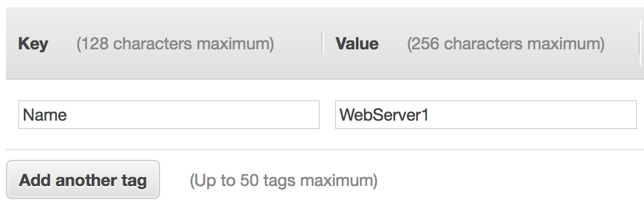
7. Add tags
A tag is a label that you can assign to an AWS resource.
Consists of a key and an optional value. Case sensitive tags
Tagging is how you can attach metadata to an EC2 instance.
Potential benefits of tagging—Filtering, automation, cost allocation, and access control.
Example:
Choices made by using the Launch Instance Wizard:
AMI
Instance Type
Network settings
IAM role
User data
Storage options
Tags
Security group
Key pair

Slide 27
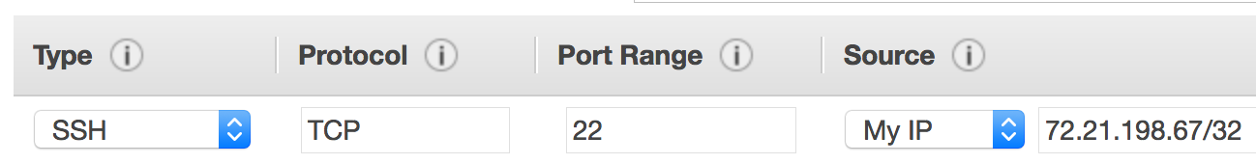
8. Security group settings
A security group is a set of firewall rules that control traffic to the instance.
It exists outside of the instance's guest OS.
Create rules that specify the source and which ports that network communications can use.
Specify the port number and the protocol, such as Transmission Control Protocol (TCP), User Datagram Protocol (UDP), or Internet Control Message Protocol (ICMP).
Specify the source (for example, an IP address or another security group) that is allowed to use the rule.
Example rule:
Choices made by using the Launch Instance Wizard:
AMI
Instance Type
Network settings
IAM role
User data
Storage options
Tags
Security group
Key pair

Slide 28


9. Identify or create the key pair
At instance launch, you specify an existing key pair or create a new key pair.
A key pair consists of –
A public key that AWS stores.
A private key file that you store.
It enables secure connections to the instance.
For Windows AMIs –
Use the private key to obtain the administrator password that you need to log in to your instance.
For Linux AMIs –
Use the private key to use SSH to securely connect to your instance.
Choices made by using the Launch Instance Wizard:
AMI
Instance Type
Network settings
IAM role
User data
Storage options
Tags
Security group
Key pair
mykey.pem

Slide 29
9. Identify or create the key pair (Cont.)
Amazon EC2 uses public–key cryptography to encrypt and decrypt login information.
The technology uses a public key to encrypt a piece of data, and then the recipient uses the private key to decrypt the data.
The public and private keys are known as a key pair.
Public-key cryptography enables you to securely access your instances by using a private key instead of a password.
Choices made by using the Launch Instance Wizard:
AMI
Instance Type
Network settings
IAM role
User data
Storage options
Tags
Security group
Key pair
mykey.pem

Slide 30
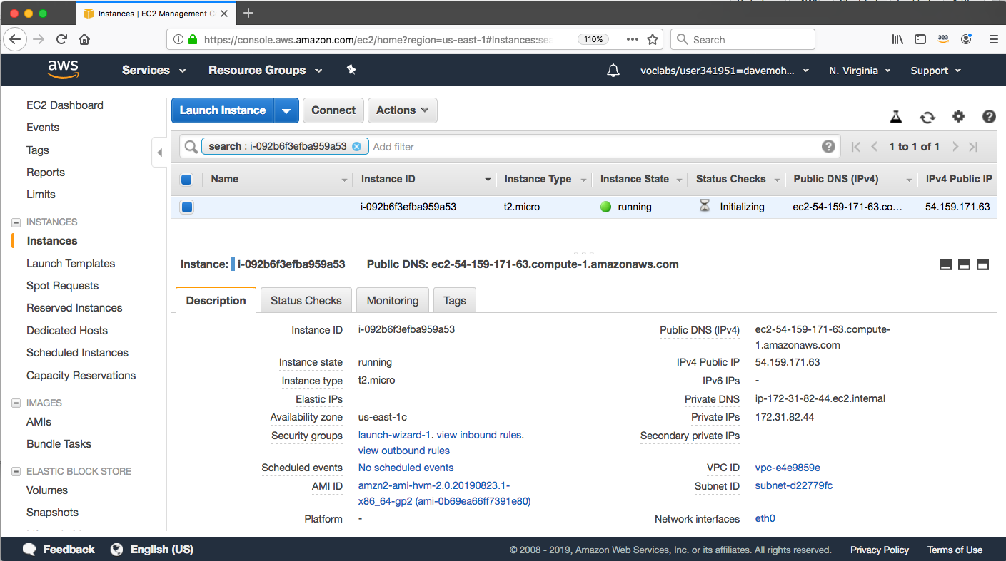
Amazon EC2 console view of a running EC2 instance Description Panel and Hyperlinks

Slide 31

Another option: Launch an EC2 instance with the AWS Command Line Interface
EC2 instances can also be created programmatically.
This example shows how simple the command can be.
This command assumes that the key pair and security group already exist.
More options could be specified. See the AWS CLI Command Reference for details.
AWS Command Line Interface (AWS CLI)
Example command:
aws ec2 run-instances \
--image-id ami-1a2b3c4d \
--count 1 \
--instance-type c3.large \
--key-name MyKeyPair \
--security-groups MySecurityGroup \
--region us-east-1

Slide 32
Another option: Launch an EC2 instance with the AWS Command Line Interface
The command should successfully create an EC2 instance if:
The command is properly formed
The resources that the command needs already exist
You have sufficient permissions to run the command
You have sufficient capacity in the AWS account
AWS Command Line Interface (AWS CLI)
Example command:
aws ec2 run-instances \
--image-id ami-1a2b3c4d \
--count 1 \
--instance-type c3.large \
--key-name MyKeyPair \
--security-groups MySecurityGroup \
--region us-east-1

Slide 33
Amazon EC2 instance lifecycle
Only instances backed by Amazon EBS
Launch
pending
Start
AMI
rebooting
Reboot
running
Stop
Stop-Hibernate
stopping
stopped
Terminate
shutting-down
terminated
Terminate

Slide 34
Instance hibernation option
Benefits
It saves the contents from the instance memory (RAM).
On instance restart, RAM contents are reloaded, previously running processes are resumed.
You can save on cost in a hibernated state versus a running state (costs are similar to a stopped instance).
Prerequisites
Only certain Linux AMIs (such as Amazon Linux 2) and only certain instance families support it.
Instance must have an encrypted Amazon EBS root volume and a maximum of150 GB RAM.
Hibernation must be enabled at instance launch.

Slide 35

Consider using an Elastic IP address
Rebooting an instance will not change any IP addresses or DNS hostnames.
When an instance is stopped and then started again –
The public IPv4 address and external DNS hostname will change.
The private IPv4 address and internal DNS hostname do not change.
For example, if the public IP address assigned to the instance is 203.0.113.25, then the external DNS hostname might be ec2-203-0-113-25.compute-1.amazonaws.com.
If you require a persistent public IP address –
Associate an Elastic IP address with the instance.
Elastic IP address characteristics –
Can be associated with instances in the Region as needed.
Remains allocated to your account until you choose to release it.
By default, all AWS accounts are limited to five (5) Elastic IP addresses per Region because public (IPv4) internet addresses are a scarce public resource.
However, this is a soft limit, and you can request a limit increase (which might be approved).
Elastic IP Address

Slide 36
EC2 instance metadata
Instance metadata is data about your instance.
While you are connected to the instance, you can view it –
In a browser: http://169.254.169.254/latest/meta-data/
In a terminal window: curl http://169.254.169.254/latest/meta-data/
Example retrievable values –
Public IP address, private IP address, public hostname, instance ID, security groups, Region, Availability Zone.
Any user data specified at instance launch can also be accessed at: http://169.254.169.254/latest/user-data/
It can be used to configure or manage a running instance.
For example, author a configuration script that reads the metadata and uses it to configure applications or OS settings.

Slide 37


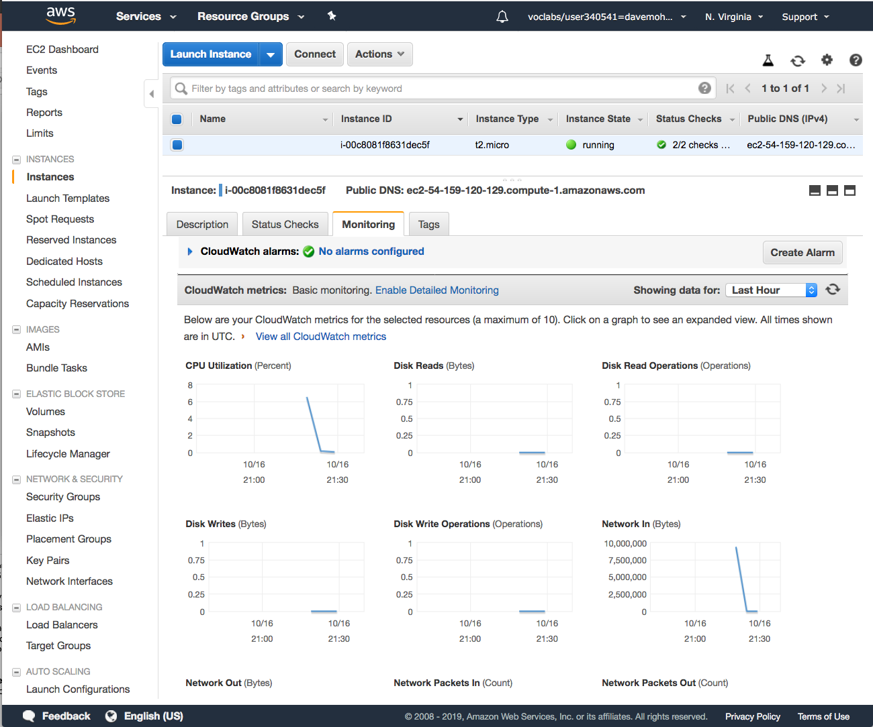
Amazon CloudWatch for monitoring
Use Amazon CloudWatch to monitor EC2 instances
Provides near-real-time metrics
Provides charts in the Amazon EC2 console Monitoring tab that you can view
Maintains 15 months of historical data
Basic monitoring
Default, no additional cost
Metric data sent to CloudWatch every 5 minutes
Detailed monitoring
Fixed monthly rate for seven pre-selected metrics
Metric data delivered every 1 minute
Amazon CloudWatch
Instance with CloudWatch

Slide 38

Section 2 key takeaways
Amazon EC2 enables you to run Windows and Linux virtual machines in the cloud.
You launch EC2 instances from an AMI template into a VPC in your account.
You can choose from many instance types. Each instance type offers different combinations of CPU, RAM, storage, and networking capabilities.
You can configure security groups to control access to instances (specify allowed ports and source).
User data enables you to specify a script to run the first time that an instance launches.
Only instances that are backed by Amazon EBS can be stopped.
You can use Amazon CloudWatch to capture and review metrics on EC2 instances.

Slide 39
Thank you
All trademarks are the property of their owners.

